Slide 1
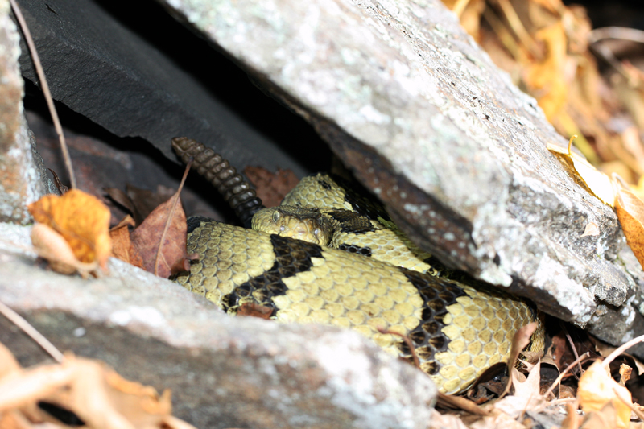
Cellular Respiration
February 27th, 2012
Video

Slide 2
Outline
Cellular Respiration
  NAD+ and FAD
  Phases of Cellular Respiration
Glycolysis
Fermentation
Preparatory Reaction
Citric Acid Cycle
Electron Transport System
Metabolic Pool
  Catabolism
  Anabolism

Slide 3
Cellular Respiration
A cellular process that breaks down carbohydrates and other metabolites with the concomitant buildup of ATP
Consumes oxygen and produces carbon dioxide (CO₂)
  Cellular respiration is an aerobic process.
Usually involves breakdown of glucose to CO₂ and water
  Energy extracted from glucose molecule:
    Released step-wise
    Allows ATP to be produced efficiently
  Oxidation-reduction enzymes include NAD⁺ and FAD as coenzymes

Slide 4
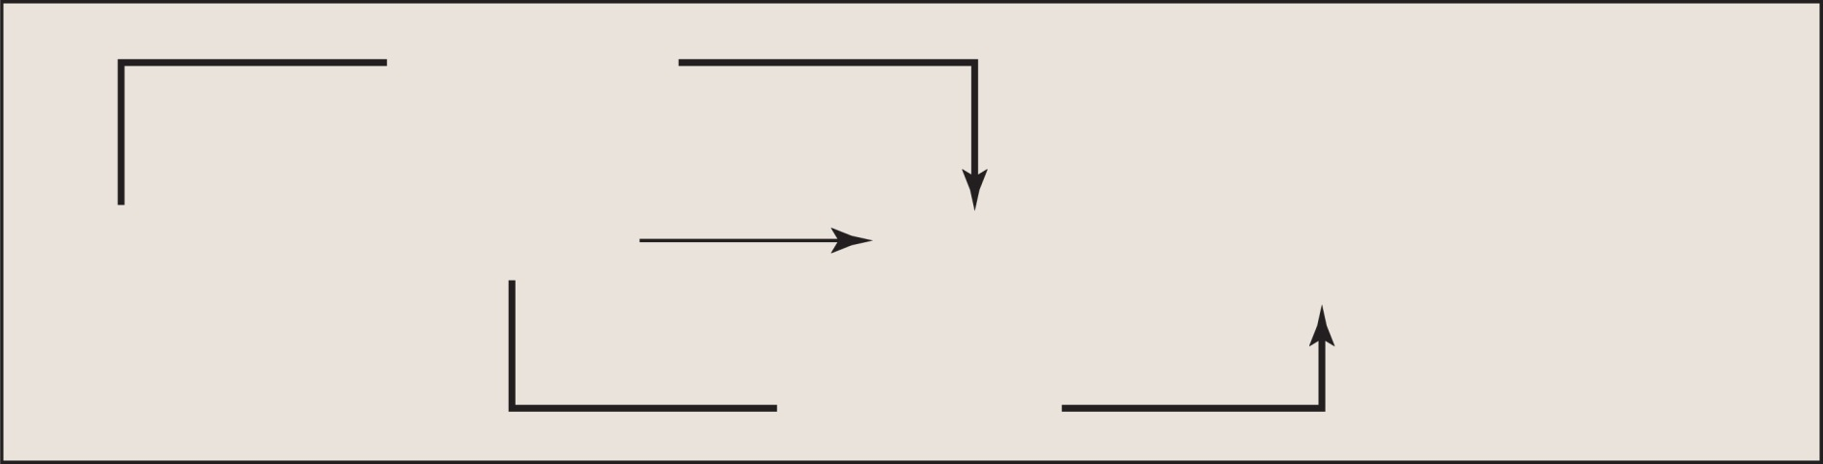
Glucose Breakdown: Summary Reaction
Copyright © The McGraw-Hill Companies, Inc. Permission required for reproduction or display.
Oxidation
C₆H₁₂O₆
+
6O₂
6CO₂
+
6HCO₂
+
energy
glucose
Reduction
Electrons are removed from substrates and received by oxygen, which combines with H+ to become water.
Glucose is oxidized and O₂ is reduced

Slide 5
NAD⁺ and FAD
NAD⁺ (nicotinamide adenine dinucleotide)
  Called a coenzyme of oxidation-reduction. It can:
    Oxidize a metabolite by accepting electrons
    Reduce a metabolite by giving up electrons
  Each NAD⁺ molecule used over and over again
FAD (flavin adenine dinucleotide)
  Also a coenzyme of oxidation-reduction
  Sometimes used instead of NAD⁺
  Accepts two electrons and two hydrogen ions (H⁺) to become FADH₂

Slide 6
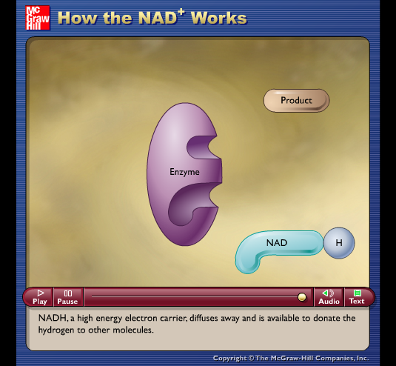
Animation
Please note that due to differing operating systems, some animations will not appear until the presentation is viewed in Presentation Mode (Slide Show view). You may see blank slides in the “Normal” or “Slide Sorter” views. All animations will appear after viewing in Presentation Mode and playing each animation. Most animations will require the latest version of the Flash Player, which is available at http://get.adobe.com/flashplayer.

Slide 7
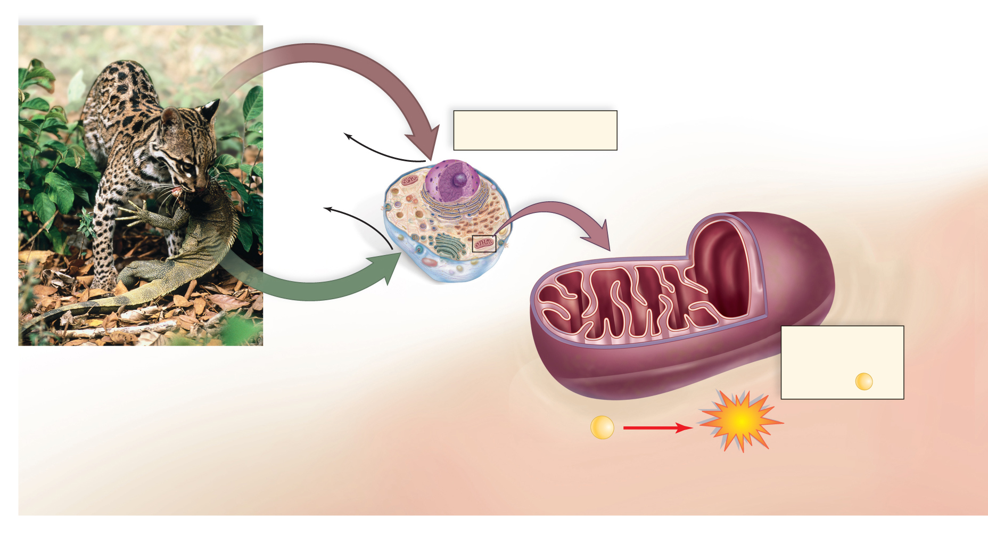
Cellular Respiration
Copyright © The McGraw-Hill Companies, Inc. Permission required for reproduction or display.
O
2
f
r
o
m
a
i
r
H₂O
O₂ and glucose enter cells,
which release H₂O and CO₂.
CO₂
g
l
u
c
o
s
e
f
r
o
m
intermembrane
space
cristae
Mitochondria use
energy from
glucose to form ATP
from ADP + P .
ADP
+
P
ATP
© E. & P. Bauer/zefa/Corbis; (Bread, wine, cheese, p. 139): © The McGraw Hill Companies, Inc./John Thoeming, photographer; (Yogurt, p. 139): © The McGraw Hill Companies, Inc./Bruce M. Johnson, photographer

Slide 8
Phases of Cellular Respiration
Cellular respiration includes four phases:
  Glycolysis is the breakdown of glucose into two molecules of pyruvate
    Occurs in cytoplasm
    ATP is formed
    Does not utilize oxygen
  Transition (preparatory) reaction
    Both pyruvates are oxidized and enter mitochondria
    Electron energy is stored in NADH
    Two carbons are released as CO₂ (one from each pyruvate)

Slide 9
Phases of Cellular Respiration
  Citric acid cycle
    Occurs in the matrix of the mitochondrion and produces NADH and FADH₂
    In series of reaction releases 4 carbons as CO₂
    Turns twice (once for each pyruvate)
    Produces two immediate ATP molecules per glucose molecule
  Electron transport chain
    Extracts energy from NADH & FADH₂
    Passes electrons from higher to lower energy states
    Produces 32 or 34 molecules of ATP

Slide 10
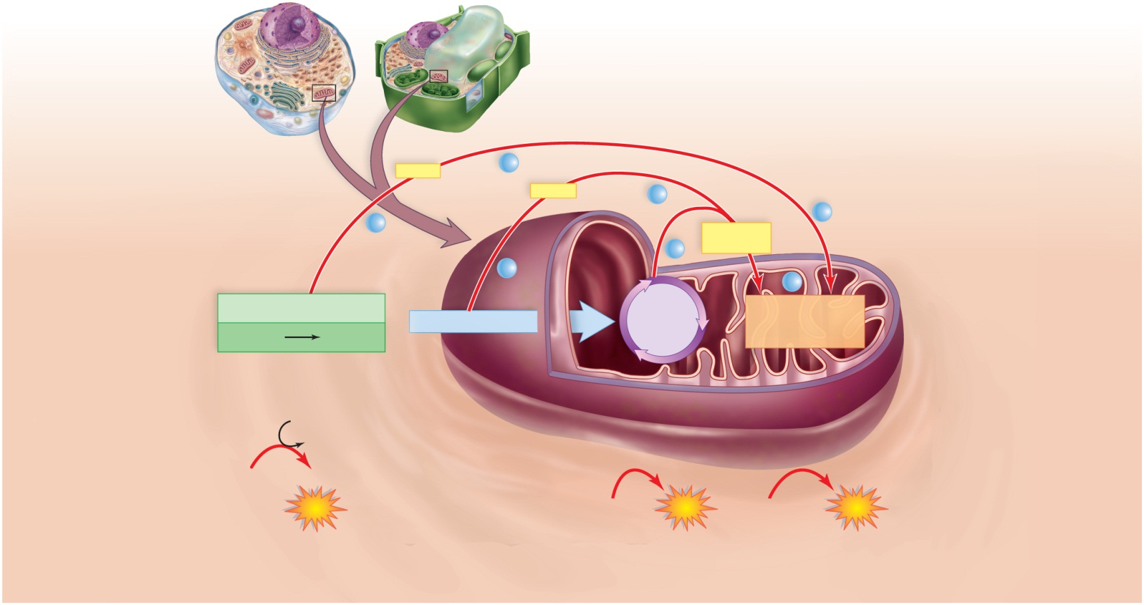
Glucose Breakdown: Overview of 4 Phases
Copyright © The McGraw-Hill Companies, Inc. Permission required for reproduction or display
NADH
e–
NADH
e–
e–
e–
NADH and
FADH₂
Cytoplasm
e–
Mitochondrion
e–
e–
Glycolysis
Preparatory reaction
Citric acid
cycle
Electron transport
chain and
chemiosmosis
glucose
pyruvate
2 ATP
2 ATP
4 ADP
4 ATP total
2
ATP
net gain
2
AD
P
2
ATP
32 ADP
or 34
32
or 34
ATP

Slide 11
Glucose Breakdown: Glycolysis
Occurs in cytoplasm outside mitochondria
Energy Investment Steps:
  Two ATP are used to activate glucose
  Glucose splits into two G3P molecules
Energy Harvesting Steps:
  Oxidation of G3P occurs by removal of electrons and hydrogen ions
  Two electrons and one hydrogen ion are accepted by NAD⁺ resulting two NADH
  Four ATP produced by substrate-level phosphorylation
  Net gain of two ATP
  Both G3Ps converted to pyruvates

Slide 12
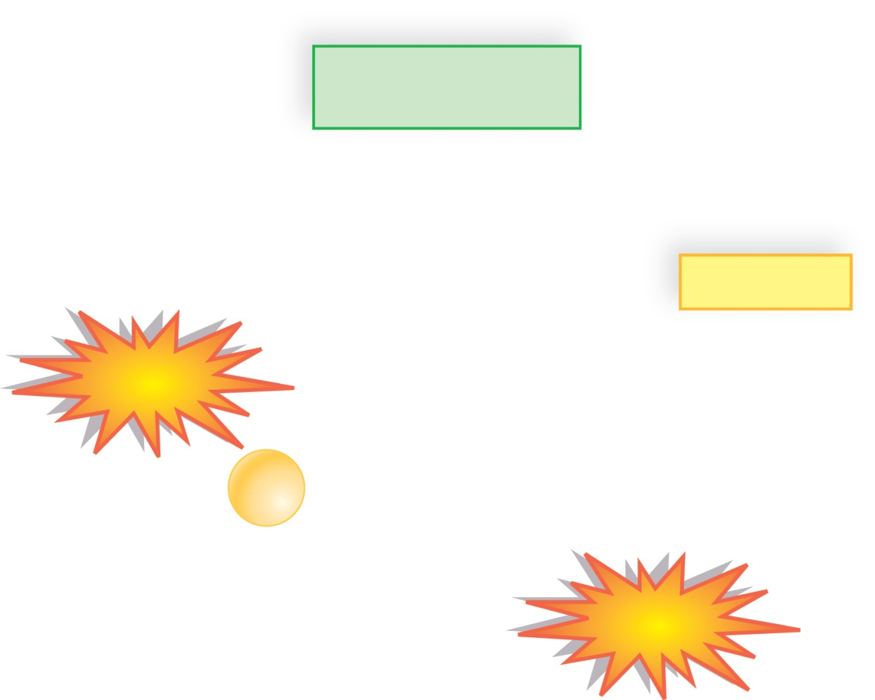
Glycolysis: Inputs and Outputs
Copyright © The McGraw-Hill Companies, Inc. Permission required for reproduction or display
Glycolysis
inputs
outputs
glucose
2 pyruvate
2 NAD⁺
2 NADH
2
ATP
2 ADP
4 ADP + 4
P
4 ATP total
2
ATP
net gain

Slide 13
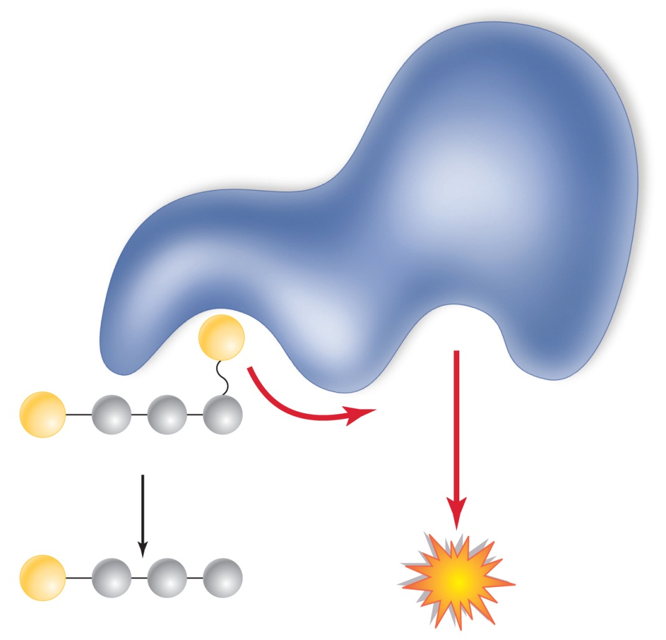
Glycolysis
Copyright © The McGraw-Hill Companies, Inc. Permission required for reproduction or display.
enzyme
P
ADP
P
BPG
P
ATP
3PG

Slide 14
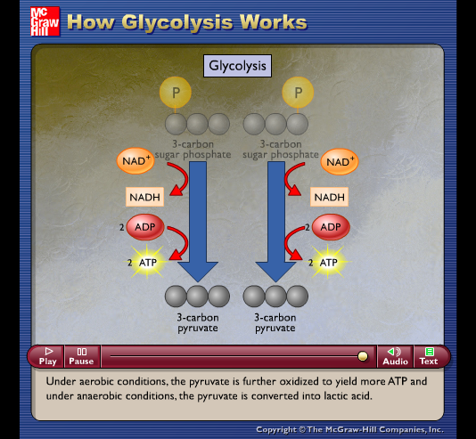
Animation
Please note that due to differing operating systems, some animations will not appear until the presentation is viewed in Presentation Mode (Slide Show view). You may see blank slides in the “Normal” or “Slide Sorter” views. All animations will appear after viewing in Presentation Mode and playing each animation. Most animations will require the latest version of the Flash Player, which is available at http://get.adobe.com/flashplayer.

Slide 15
Pyruvate
Pyruvate is a pivotal metabolite in cellular respiration
If O₂ is not available to the cell, fermentation, an anaerobic process, occurs in the cytoplasm.
  During fermentation, glucose is incompletely metabolized to lactate, or to CO₂ and alcohol (depending on the organism).
If O₂ is available to the cell, pyruvate enters mitochondria by aerobic process.

Slide 16
Fermentation
An anaerobic process that reduces pyruvate to either lactate or alcohol and CO₂
NADH passes its electrons to pyruvate
Alcoholic fermentation, carried out by yeasts, produces carbon dioxide and ethyl alcohol
  Used in the production of alcoholic spirits and breads.
Lactic acid fermentation, carried out by certain bacteria and fungi, produces lactic acid (lactate)
  Used commercially in the production of cheese, yogurt, and sauerkraut.
Other bacteria produce chemicals anaerobically, including isopropanol, butyric acid, proprionic acid, and acetic acid.

Slide 17
Fermentation
Advantages
  Provides a quick burst of ATP energy for muscular activity.
Disadvantages
  Lactate is toxic to cells.
  Lactate changes pH and causes muscles to fatigue.
  Oxygen debt and cramping
Efficiency of Fermentation
  Two ATP produced per glucose of molecule during fermentation is equivalent to 14.6 kcal.

Slide 18
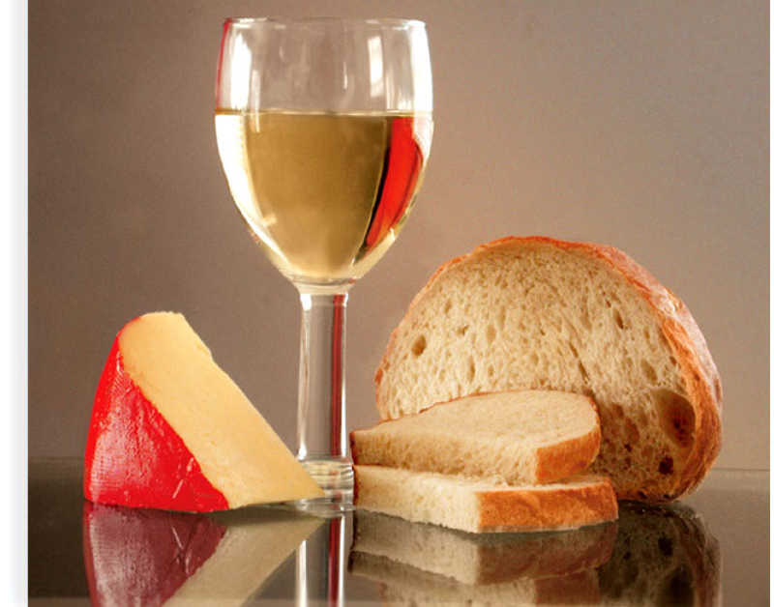
Products of Fermentation
Copyright © The McGraw-Hill Companies, Inc. Permission required for reproduction or display.
© The McGraw Hill Companies, Inc./Bruce M. Johnson, photographer

Slide 19
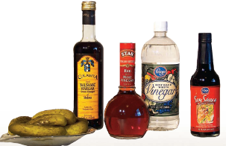
Products of Fermentation
Copyright © The McGraw-Hill Companies, Inc. Permission required for reproduction or display.
© The McGraw Hill Companies, Inc./Bruce M. Johnson, photographer

Slide 20
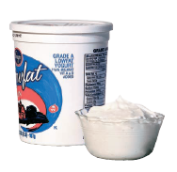
Products of Fermentation
Copyright © The McGraw-Hill Companies, Inc. Permission required for reproduction or display.
© The McGraw Hill Companies, Inc./Bruce M. Johnson, photographer

Slide 21
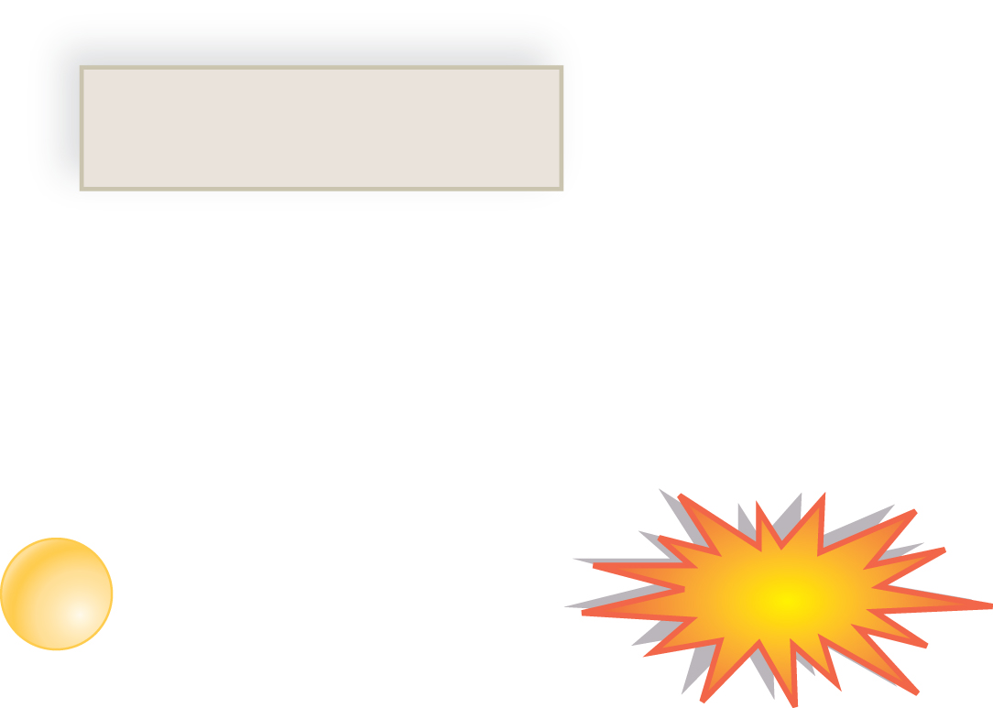
Efficiency of Fermentation
Copyright © The McGraw-Hill Companies, Inc. Permission required for reproduction or display.
Fermentation
inputs
outputs
glucose
2 lactate or
2 alcohol and 2 CO₂
2 ADP + 2
P
2
ATP
net gain

Slide 22
The Preparatory (Prep) Reaction
Connects glycolysis to the citric acid cycle
End product of glycolysis, pyruvate, enters the mitochondrial matrix
Pyruvate converted to 2-carbon acetyl group
  Attached to Coenzyme A to form acetyl-CoA
  Electron picked up (as hydrogen atom) by NAD⁺
  CO₂ released, and transported out of mitochondria into the cytoplasm

Slide 23
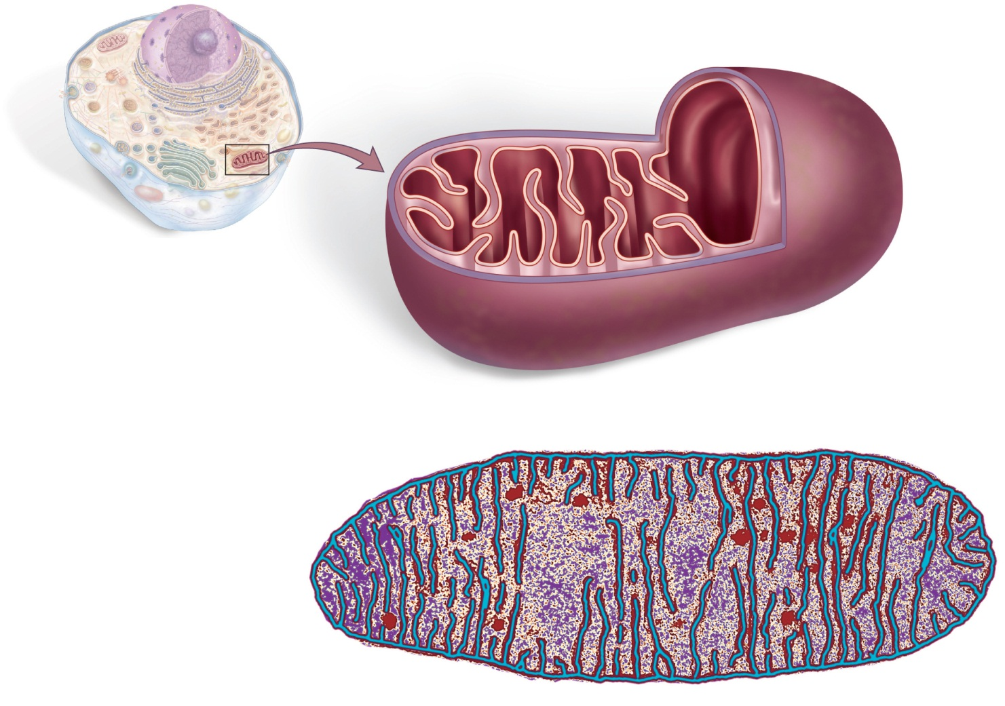
Mitochondrion: Structure & Function
Copyright © The McGraw-Hill Companies, Inc. Permission required for reproduction or display.
Cristae: location
of the electron
transport chain
(ETC)
Matrix: location
of the prep
reaction and the
citric acid cycle
outer
membrane
inner
membrane
intermembrane
space
matrix
cristae
45,000
© Dr. Donald Fawcett and Dr. Porter/Visuals Unlimited

Slide 24
Glucose Breakdown: The Citric Acid Cycle
A.K.A. Krebs cycle
Occurs in matrix of mitochondria
Begins by the addition of a two-carbon acetyl group to a four-carbon molecule (oxaloacetate), forming a six-carbon molecule (citric acid)
NADH, FADH₂ capture energy rich electrons
ATP formed by substrate-level phosphorylation
Turns twice for one glucose molecule.
Produces 4 CO2, 2 ATP, 6 NADH and 2 FADH2 (per glucose molecule)

Slide 25
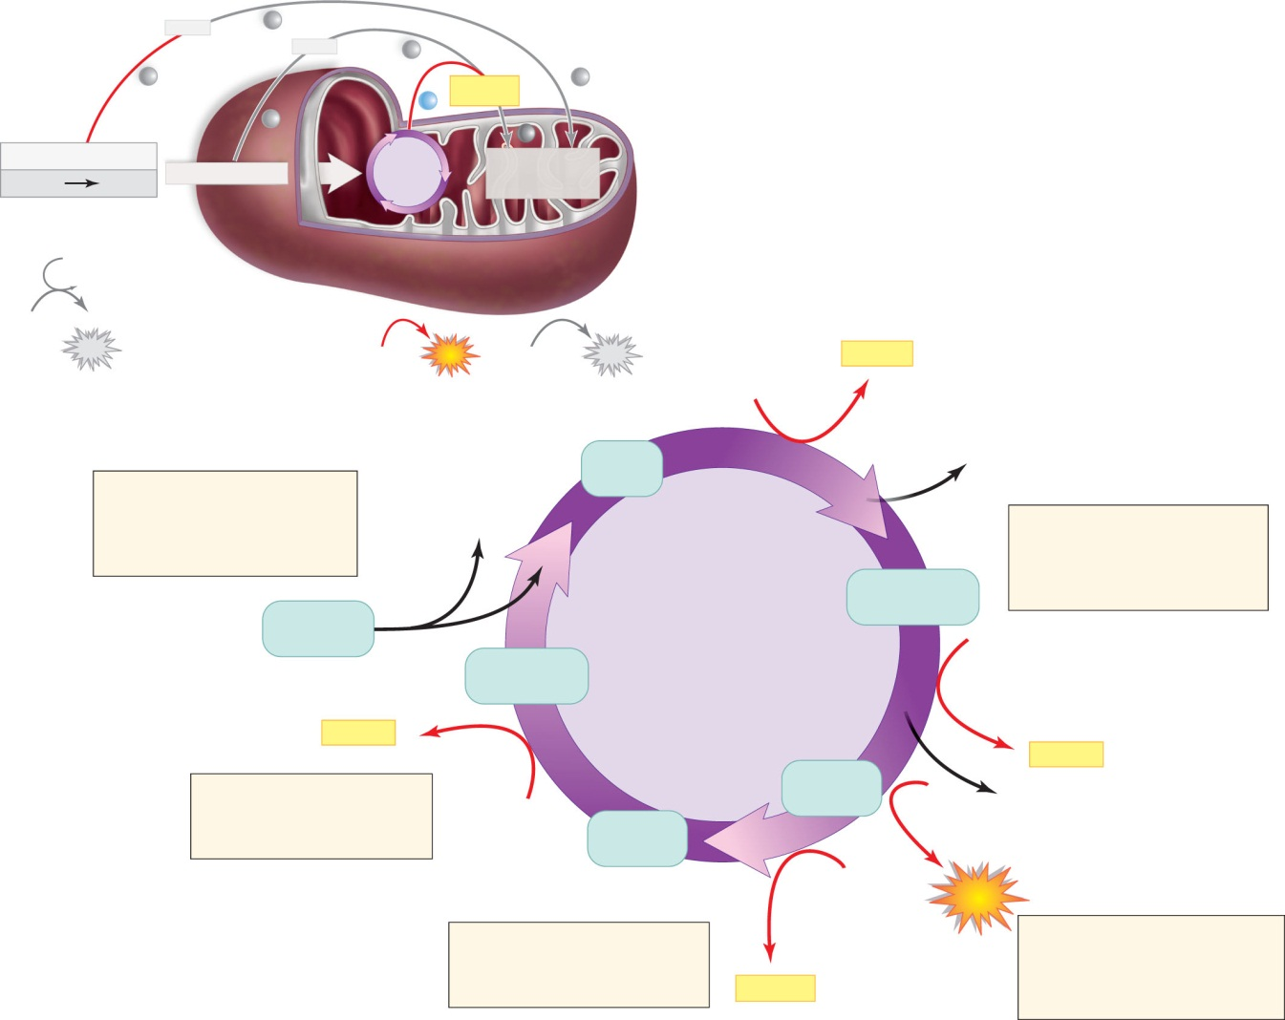
The Citric Acid Cycle
Copyright © The McGraw-Hill Companies, Inc. Permission required for reproduction or display.
NADH
NADH
NADH and
FADH2
glucose
Glycolysis
Preparatory reaction
Citric acid
cycle
Electron transport
chain and
chemiosmosis
pyruvate
2 ATP
2 ADP
4 ADP
2
4 ATP total
ATP
net
2 ADP 2
ATP
32 ADP
or 34
32
or 34
ATP
NAD⁺
NADH
citrate
C₆
CO₂
1. The cycle begins when
an acetyl group carried by
CoA combines with a C₄
molecule to form citrate.
CoA
2. Twice over, substrates
are oxidized as NAD⁺ is
reduced to NADH,
and CO₂ is released.
ketoglutarate
C₅
acetyl CoA
Citric acid
cycle
NAD⁺
oxaloacetate
C₄
NADH
NADH
5. Once again a substrate
is oxidized, and NAD⁺
is reduced to NADH.
succinate
C₄
NAD⁺
fumarate
C₄
CO₂
FAD
ATP
4. Again a substrate is
oxidized, but this time
FAD is reduced to FADH₂.
3. ATP is produced as an
energized phosphate is
transferred from a substrate
to ADP.
FADH₂

Slide 26
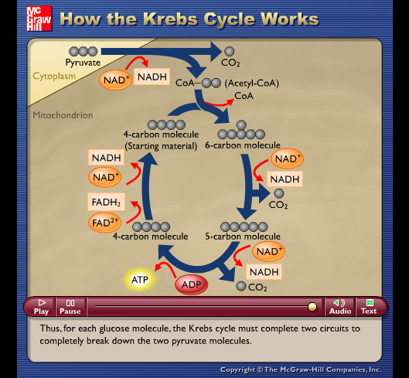
Animation
Please note that due to differing operating systems, some animations will not appear until the presentation is viewed in Presentation Mode (Slide Show view). You may see blank slides in the “Normal” or “Slide Sorter” views. All animations will appear after viewing in Presentation Mode and playing each animation. Most animations will require the latest version of the Flash Player, which is available at http://get.adobe.com/flashplayer.

Slide 27
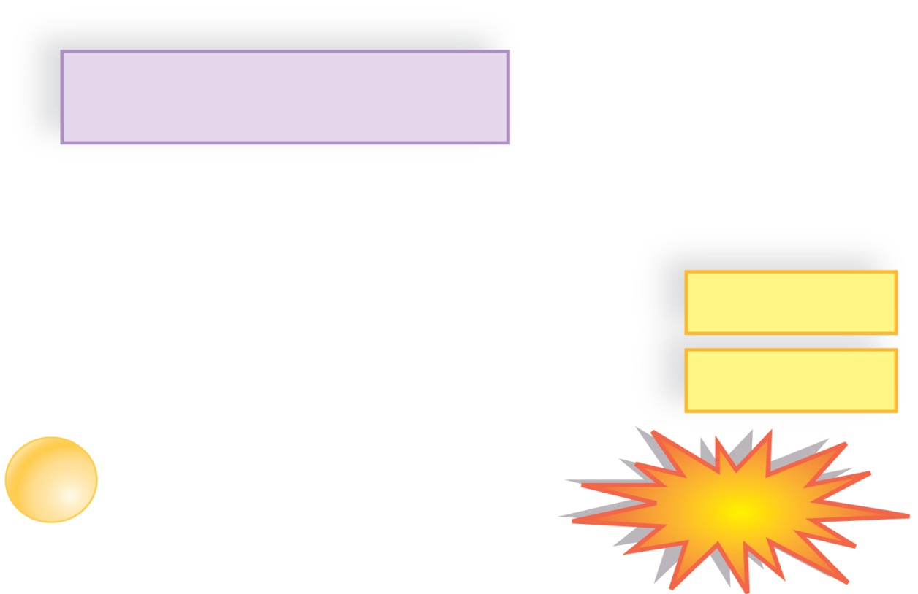
Citric Acid Cycle: Balance Sheet
Copyright © The McGraw-Hill Companies, Inc. Permission required for reproduction or display.
Citric acid cycle
inputs
outputs
2 acetyl groups
4 CO₂
6 NAD⁺
6 NADH
2 FAD
2 FADH₂
2 ADP + 2
P
2
ATP

Slide 28
Electron Transport Chain
Location:
  Eukaryotes: cristae of the mitochondria
  Aerobic Prokaryotes: plasma membrane
Series of carrier molecules:
  Pass energy rich electrons successively from one to another
  Complex arrays of protein and cytochromes
    Cytochromes are respiratory molecules
    Complex carbon rings with metal atoms in center
Receives electrons from NADH & FADH₂
Produce ATP by oxidative phosphorylation
Oxygen serves as a final electron acceptor
  Oxygen ion combines with hydrogen ions to form water

Slide 29
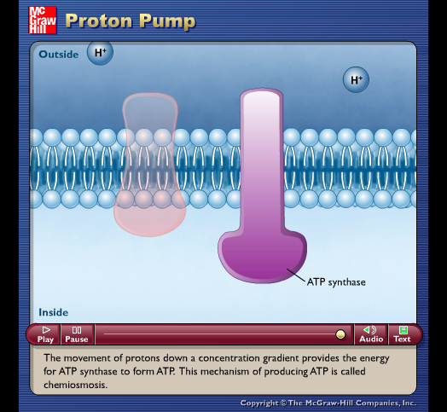
Animation
Please note that due to differing operating systems, some animations will not appear until the presentation is viewed in Presentation Mode (Slide Show view). You may see blank slides in the “Normal” or “Slide Sorter” views. All animations will appear after viewing in Presentation Mode and playing each animation. Most animations will require the latest version of the Flash Player, which is available at http://get.adobe.com/flashplayer.

Slide 30
Electron Transport Chain
The fate of the hydrogens:
Hydrogens from NADH deliver enough energy to make 3 ATPs
  Those from FADH₂ have only enough for 2 ATPs
  “Spent” hydrogens combine with oxygen
Recycling of coenzymes increases efficiency
  Once NADH delivers hydrogens, it returns (as NAD⁺) to pick up more hydrogens
  However, hydrogens must be combined with oxygen to make water
  If O₂ not present, NADH cannot release H
  No longer recycled back to NAD⁺

Slide 31
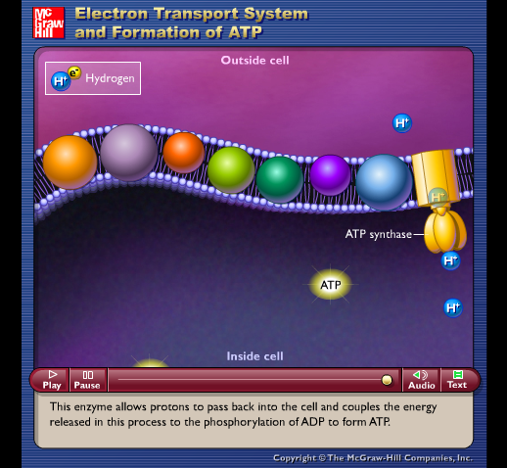
Animation
Please note that due to differing operating systems, some animations will not appear until the presentation is viewed in Presentation Mode (Slide Show view). You may see blank slides in the “Normal” or “Slide Sorter” views. All animations will appear after viewing in Presentation Mode and playing each animation. Most animations will require the latest version of the Flash Player, which is available at http://get.adobe.com/flashplayer.

Slide 32
Glucose Catabolism: Overall Energy Yield
Net yield per glucose:
  From glycolysis – 2 ATP
  From citric acid cycle – 2 ATP
  From electron transport chain – 32 ATP
Energy content:
  Reactant (glucose) 686 kcal
  Energy yield (36 ATP) 263 kcal
  Efficiency 39%; balance is waste heat

Slide 33
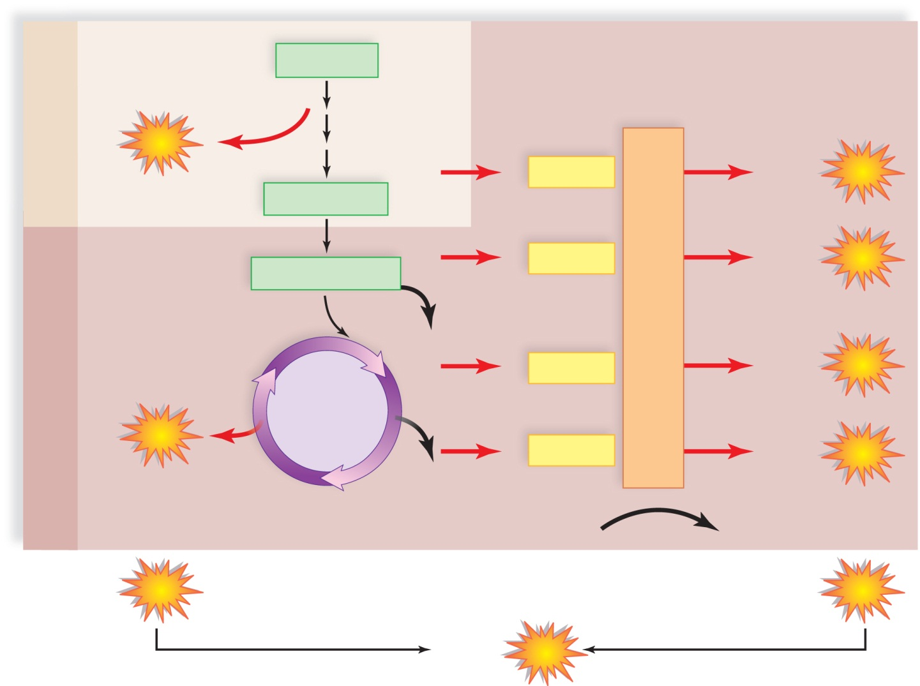
Overall Energy Yielded per Glucose Molecule
Copyright © The McGraw-Hill Companies, Inc. Permission required for reproduction or display.
glucose
Cytoplasm
2
A
T
P
glycolysis
net
2
NADH
4 or 6
ATP
2 pyruvate
2 acetyl CoA
2
NADH
6
ATP
Electron transport chain
2 CO₂
6
NADH
18
ATP
Mitochondrion
Citric acid
cycle
2
ATP
2
FADH₂
4
ATPP
4 CO₂
6 O₂
6 H₂O
subtotal
4
ATP
subtotal
32
ATP
or 34
36 or 38
ATP
total

Slide 34
Metabolic Pool: Catabolism
Glucose is broken down in cellular respiration.
Fat breaks down into glycerol and three fatty acids.
Amino acids break down into carbon chains and amino groups
  Deaminated (NH₂ removed) in liver
    Results in poisonous ammonia (NH₃)
    Quickly converted to urea
  Different R-groups from AAs processed differently
  Fragments enter respiratory pathways at many different points

Slide 35
Metabolic Pool: Anabolism
All metabolic reactions part of metabolic pool
Intermediates from respiratory pathways can be used for anabolism
Anabolism (build-up side of metabolism):
  Carbs:
    Start with acetyl-CoA
    Basically reverses glycolysis (but different pathway)
  Fats
    G3P converted to glycerol
    Acetyls connected in pairs to form fatty acids
    Note – dietary carbohydrate RARELY converted to fat in humans!

Slide 36
Metabolic Pool: Anabolism
Anabolism (cont.):
  Proteins:
    Made up of combinations of 20 different amino acids
    Some amino acids (11) can be synthesized from respiratory intermediates
      Organic acids in citric acid cycle can make amino acids
      Add NH₂ – transamination
    However, other amino acids (9) cannot be synthesized by humans
      Essential amino acids
      Must be present in diet or die

